Slide 1
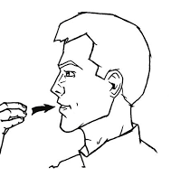
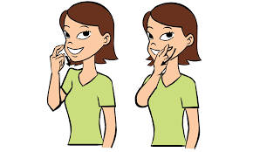
Food & Restaurant
Unit 2.5

Slide 2
Unit Overview
Week 1: Breakfast, dessert, drink, lunch, dinner, toppings
Week 2: Restaurant, Ordering, Menu, Preferences
Week 3: Group Project Work
Week 4: Group Project Presentations & Conferences

Slide 3
Day 1
Breakfast, Desserts, Drinks

Slide 4
Breakfast
Eggs
Bacon
Sausage
Pancakes
Waffles
Cereal
Fruit

Slide 5
Dessert
Ice Cream
Cake
Cupcake
Pie

Slide 6
Drink
Water
Tea
Soda
Coffee
Milk
Juice

Slide 7
Activity
Partner 1: Fingerspell vocabulary word
Partner 2: Sign the vocabulary word
SWITCH

Slide 8
HOMEWORK
Look up the sign for your favorite breakfast, dessert, or drink (must be a sign we have not learned yet)
This will be your password for tomorrow!

Slide 9
Day 2
Lunch, Dinner, Toppings

Slide 10
REVIEW

Slide 11
Lunch & Dinner
Meat
Chicken
Soup
Sandwich
Pizza
French Fries
Hot Dog
Spaghetti

Slide 12
Toppings & Extras
Ketchup
Mustard
Onions
Pickles
Cheese
Bread
Butter

Slide 13
Show & Tell
Break into teams of 3-4
Teacher will sign a vocabulary word
Each team will write down what sign is being shown
1 point for each correct answer

Slide 14
Homework
Look up the sign for your favorite lunch/dinner (it must be a new sign)
This will be the password for tomorrow!

Slide 15
Day 3
Food Vocabulary Review

Slide 16
Class Activity What’s the sign?
Divide into two teams. Each round ONE person plays.
Teacher fingerspells a vocabulary word.
The student who signs the word correctly gets the point

Slide 17
Homework
FLIP!
Post yourself spelling two vocabulary words
RESPOND to one person, sign the vocabulary word they signed.

Slide 18
Day 4
Food Vocabulary Review

Slide 19
Class Activity “Pick a Card” Layering Game
Divide into teams of 2
Each team picks a vocabulary card
1st team signs a word, 2nd team signs 1st teams' word and theirs, and so on.

Slide 20
TEST TOMORROW
Be prepared to watch signs and write the word
AND
Be given words to sign

Slide 21
Day 5
TEST
ASL FRIDAY: Deaf Owned Restaurants
Video Comprehension Questions

Slide 22
RECEPTIVE TEST
Write down the vocabulary word the teacher signs.

Slide 23
Deaf Culture FRIDAY
https://youtu.be/4omr1voLLbY

Slide 24
EXPRESSIVE TEST
Work on the Deaf Culture Comprehension Questions while waiting for your turn or once your turn is completed.

