Slide 1
WEEK 2
Food & Restaurant

Slide 2
Day 1

Slide 3
Review Show and Sign

Slide 4
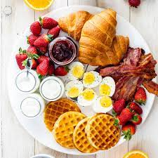

Slide 5
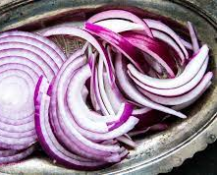

Slide 8
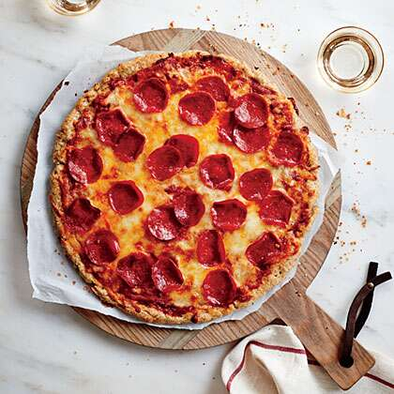

Slide 9
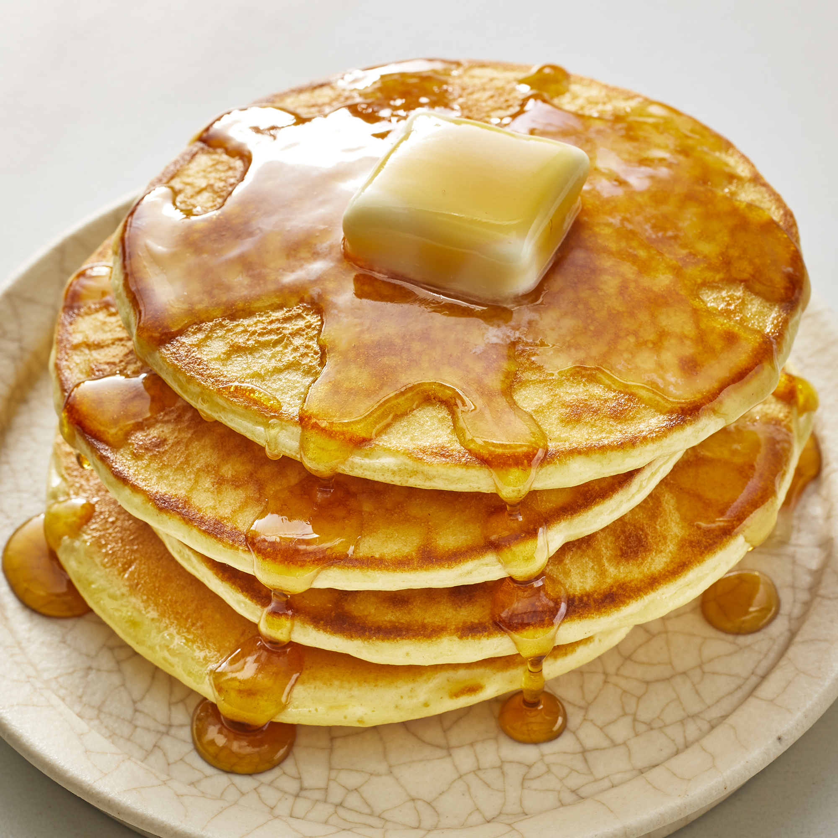

Slide 10
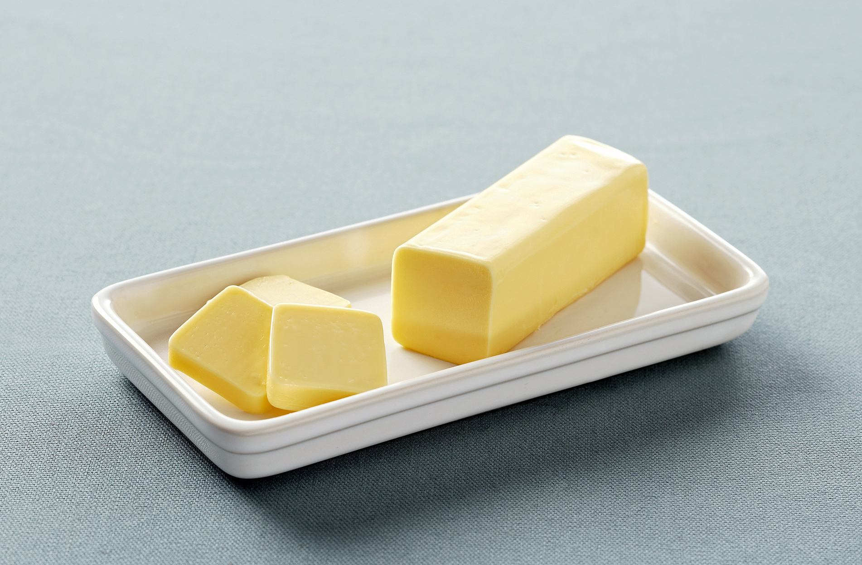

Slide 11
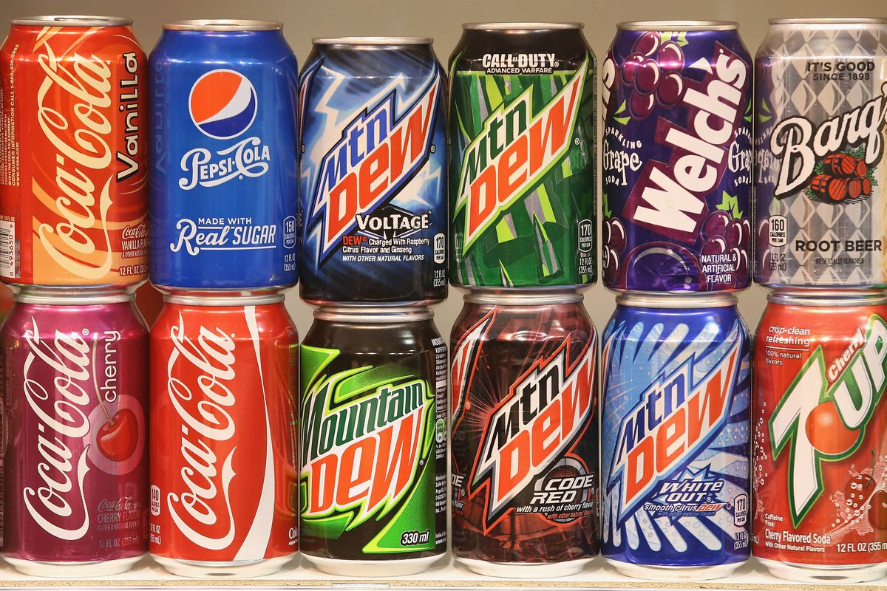

Slide 12
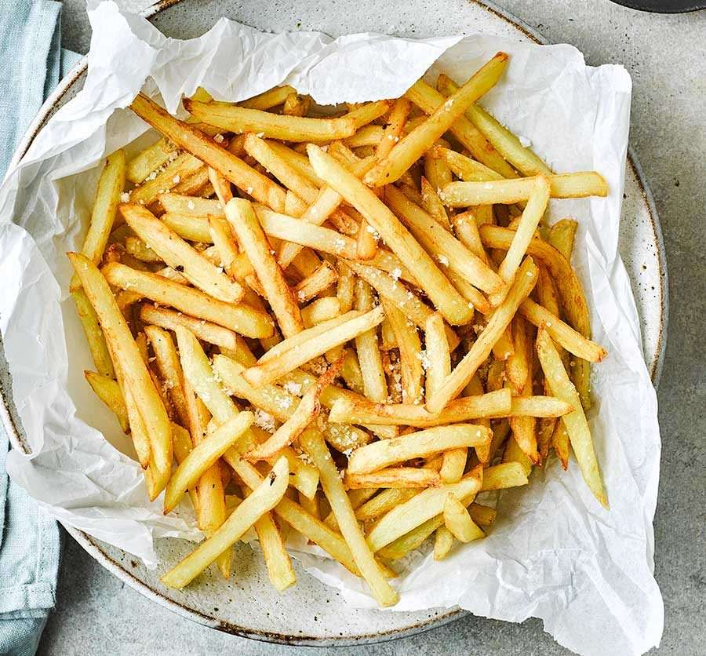

Slide 13
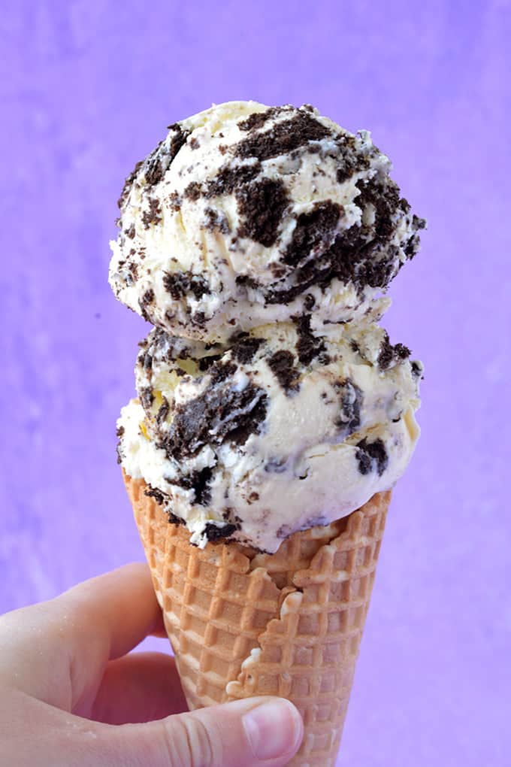

Slide 15
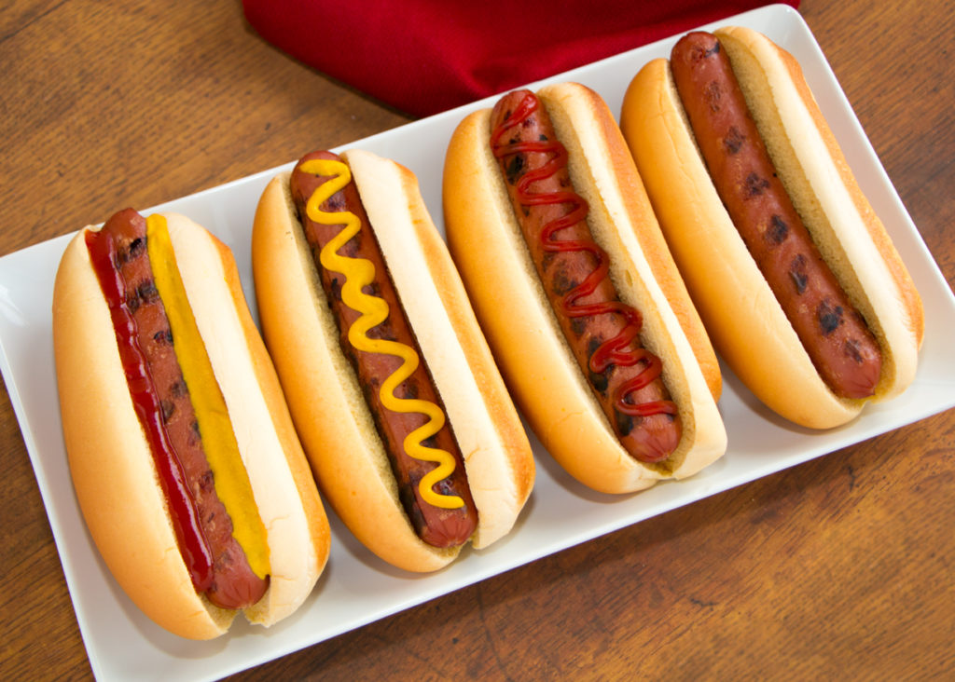

Slide 16
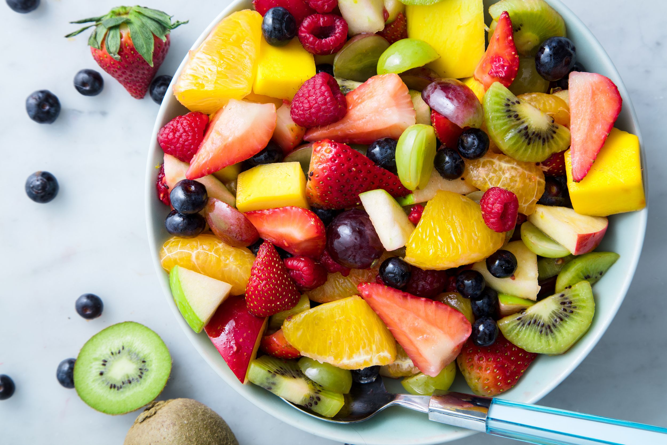

Slide 17
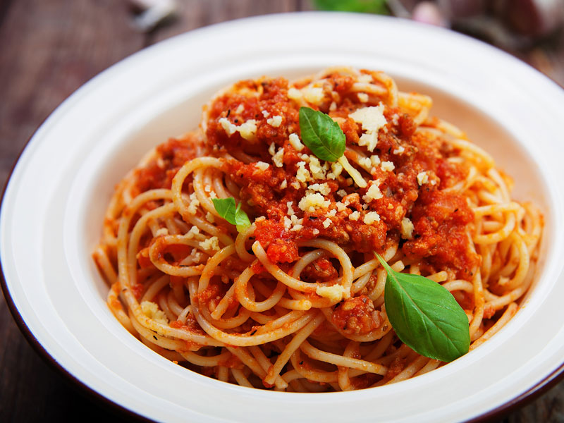

Slide 18
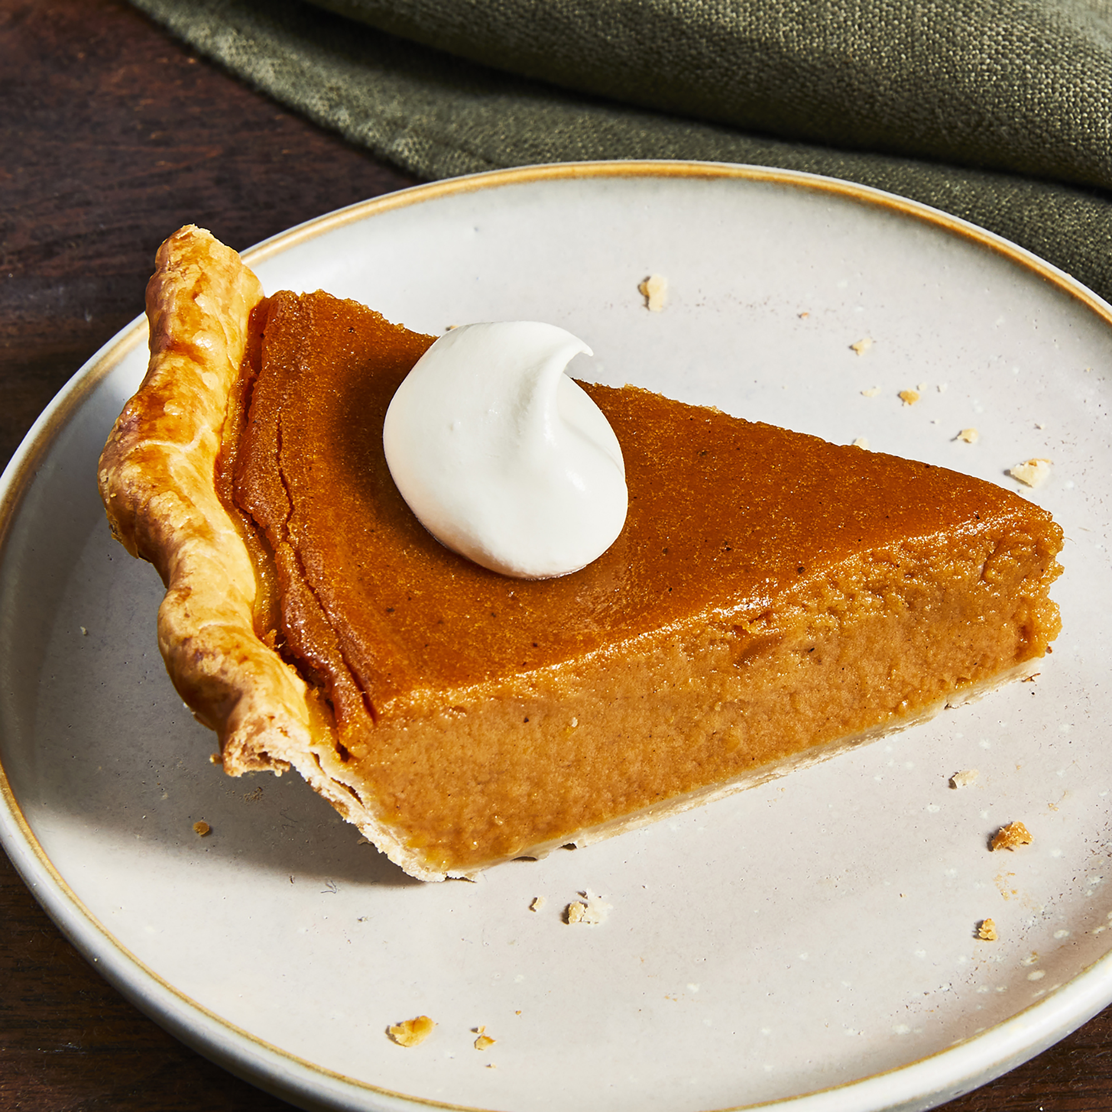

Slide 19
ASL TELEPHONE

Slide 20
Day 2

Slide 21
Restaurant, Order, Menu Signs
Restaurant
Appetizer
Order
Menu
Fork
Spoon
Knife
Straw
Bill
Tip

Slide 22
Practice with Partner

Slide 23
Preferences & Structure
NEGATIVES
ME WANT _______________
ME NEED ________________
ME LIKE ________________
ME PREFER/FAVORITE ________________
YOU LIKE _______________
YOU FAVORITE _____________ WHAT
ME DONT-WANT ________________
ME DONT-NEED _______________
ME DONT-LIKE ________________
YOU DONT-LIKE WHAT

Slide 24
Partner dialogue Practice

Slide 25
homework
FLIP!
Post a food/restaurant related question.
Respond with an answer to at LEAST one classmate.

Slide 26
Day 3

Slide 27
Group Project
Introduce project requirements
Sign ups
Begin planning/work
Reminder: Grammar/Structure Test Tomorrow!

